Slide 1
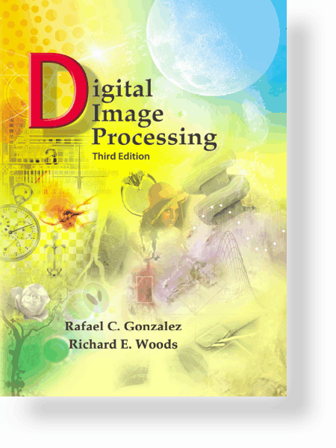
UNIT – III: Image Restoration and Reconstruction
Syllabus
A Model of the Image Degradation/Restoration Process
Noise Models
Restoration in the Presence of Noise only – Spatial filtering
Estimating the Degradation Function
Inverse Filtering
Wiener Filtering
Constrained Least Squares Filtering

Slide 2
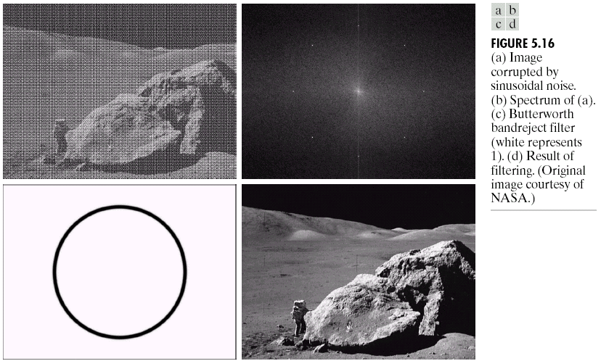
UNIT – III: Image Restoration and Reconstruction
Image Restoration
Image restoration: recover an image that has been degraded by using a prior knowledge of the degradation phenomenon.
Similar to image enhancement, but more objective
Model the degradation and applying the inverse process in order to recover the original image.
9/25/2023

Slide 3
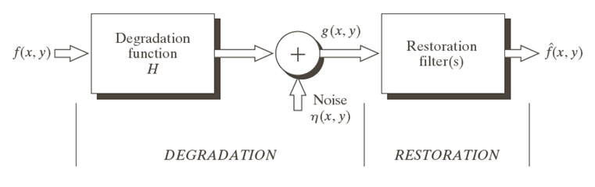
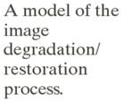
UNIT – III: Image Restoration and Reconstruction
A Model of Image Degradation/Restoration Process
9/25/2023

Slide 4
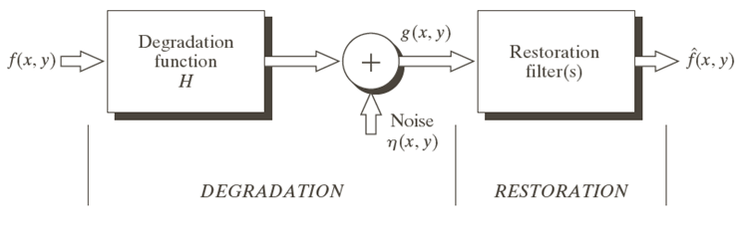
UNIT – III: Image Restoration and Reconstruction
Contd…
9/25/2023

Slide 5
UNIT – V: Image Degradation/Restoration
Contd…
9/25/2023

Slide 6
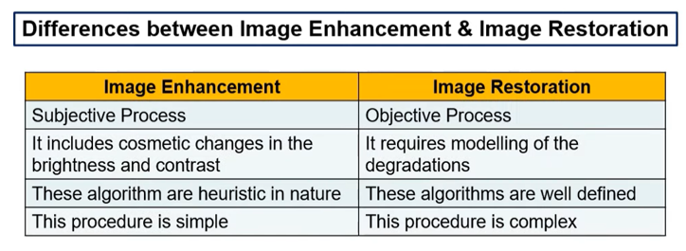
UNIT – III: Image Restoration and Reconstruction

Slide 7
UNIT – III: Image Restoration and Reconstruction
Noise Sources
The principal sources of noise in digital images arise during image acquisition and/or transmission
Image acquisition
e.g., light levels, sensor temperature, etc.
Transmission
e.g., lightning or other atmospheric disturbance in wireless network
9/25/2023

Slide 8
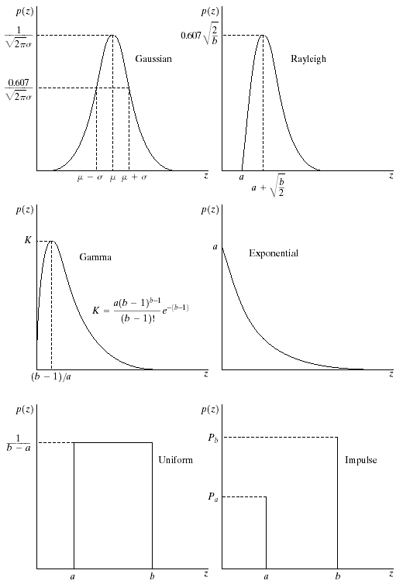
UNIT – III: Image Restoration and Reconstruction
Noise Models
There are many different models for the image noise term η(x, y):
Gaussian
Most common model
Rayleigh
Erlang
Exponential
Uniform
Impulse
Salt and pepper noise
Gaussian
Rayleigh
Erlang
Exponential
Uniform
Impulse
9/25/2023

Slide 9
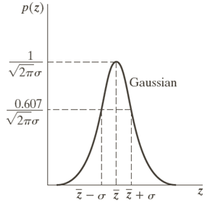
UNIT – III: Image Restoration and Reconstruction
Gaussian Noise
70% of its values will be in the range
95% of its values will be in the range
9/25/2023

Slide 10
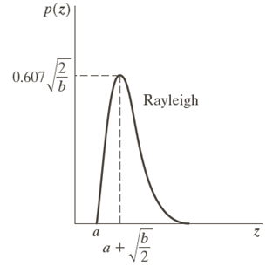
UNIT – III: Image Restoration and Reconstruction
Rayleigh Noise
9/25/2023

Slide 11
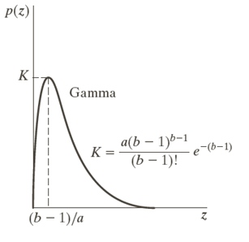
UNIT – III: Image Restoration and Reconstruction
Erlang (Gamma) Noise
9/25/2023

Slide 12
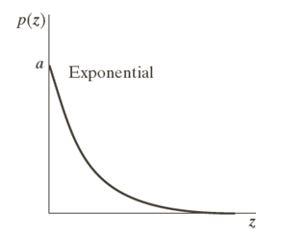
UNIT – III: Image Restoration and Reconstruction
Exponential Noise
9/25/2023

Slide 13
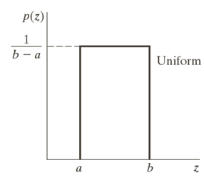
UNIT – III: Image Restoration and Reconstruction
Uniform Noise
9/25/2023

Slide 14
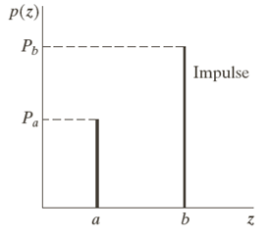
UNIT – III: Image Restoration and Reconstruction
Impulse (Salt-and-Pepper) Noise
9/25/2023

Slide 15
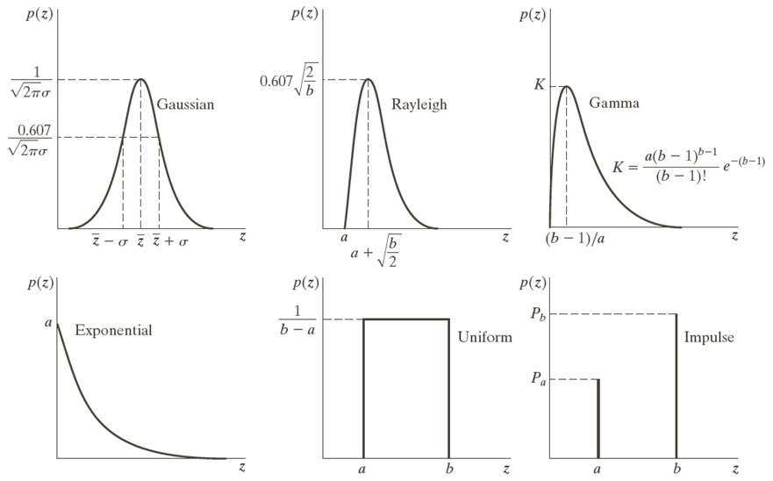
9/25/2023

Slide 16
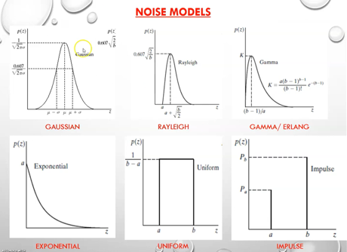
9/25/2023

Slide 17
UNIT – III: Image Restoration and Reconstruction
Examples of Noise: Original Image
9/25/2023

Slide 18
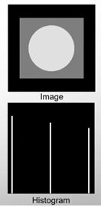
UNIT – III: Image Restoration and Reconstruction
Examples of Noise: Original Image
9/25/2023

Slide 19
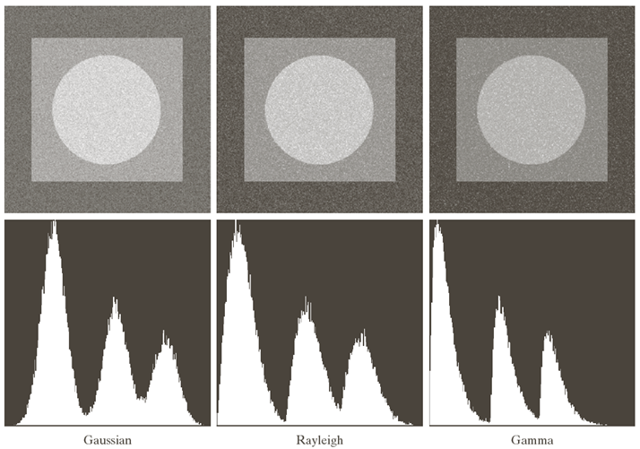

9/25/2023

Slide 20
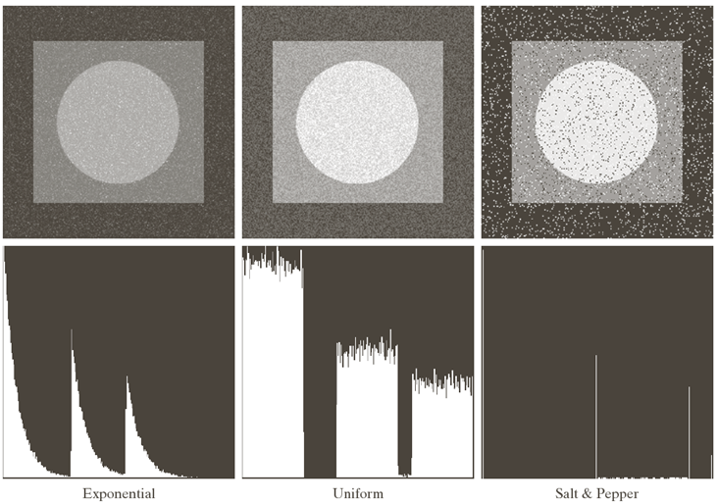
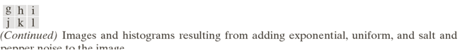
9/25/2023

Slide 21
UNIT – III: Image Restoration and Reconstruction
Periodic Noise
Periodic noise in an image arises typically from electrical or electromechanical interference during image acquisition.
It is a type of spatially dependent noise
Periodic noise can be reduced significantly via frequency domain filtering
9/25/2023

Slide 22
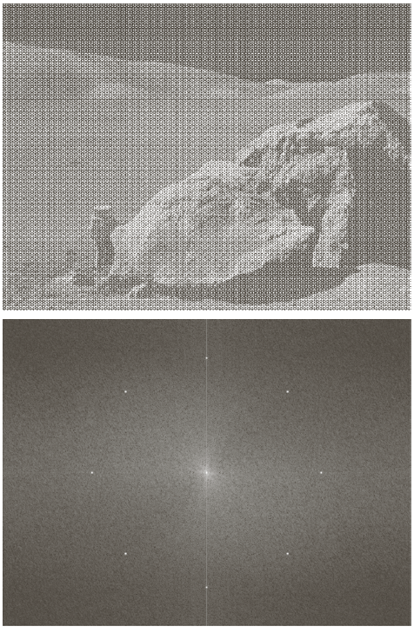
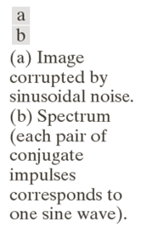
UNIT – III: Image Restoration and Reconstruction
An Example of Periodic Noise
9/25/2023

Slide 23
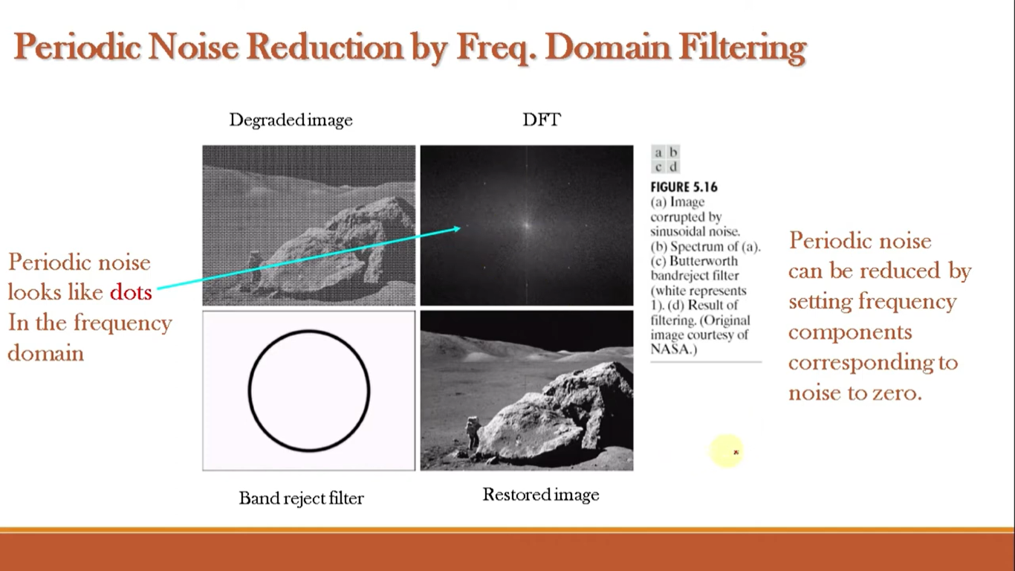
UNIT – III: Image Restoration and Reconstruction
An Example of Periodic Noise
9/25/2023

Slide 24
UNIT – III: Image Restoration and Reconstruction
Restoration in the Presence of Noise Only ̶ Spatial Filtering
To remove this part
9/25/2023

Slide 25
UNIT – III: Image Restoration and Reconstruction
Contd…
Mean Filters
Arithmetic mean filter
Geometric mean filter
Harmonic mean filter
Contra harmonic mean filter
Order-Statistics Filters
Median filter
Max and Min filters
Midpoint filter
Alpha-trimmed mean filter
Adaptive Filters
Adaptive, local noise reduction filter
Adaptive median filter
9/25/2023

Slide 26
UNIT – III: Image Restoration and Reconstruction
Mean Filter
mn = size of moving window
This is implemented as the simple smoothing filter Blurs the image to remove noise
9/25/2023

Slide 27
UNIT – III: Image Restoration and Reconstruction
Geometric mean filter
mn = size of moving window
Achieves similar smoothing to the arithmetic mean, but tends to lose less image detail
9/25/2023

Slide 28
UNIT – III: Image Restoration and Reconstruction
Harmonic mean filter
mn = size of moving window
It works well for salt noise, but fails for pepper noise
It does well also with other types of noise like Gaussian noise
9/25/2023

Slide 29
UNIT – III: Image Restoration and Reconstruction
Contra harmonic filter
Q = the filter order
mn = size of moving window
For Q = 0, the filter reduces to an arithmetic mean filter.
For Q = -1, the filter reduces to a harmonic mean filter.
It is well suited for reducing the effects of salt-and-pepper noise.
Q>0 for pepper noise and Q<0 for salt noise.
9/25/2023

Slide 30
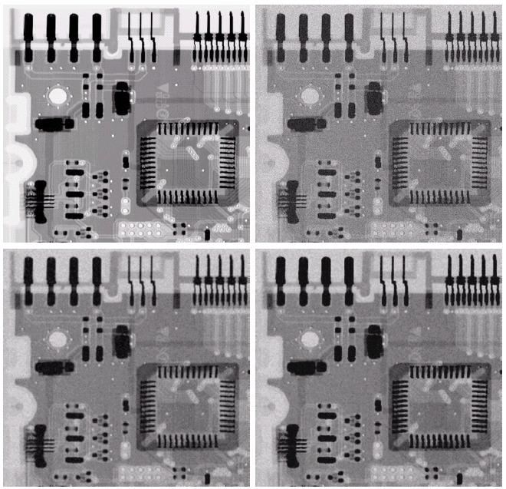
Example: Arithmetic & Geometric mean filters
Image
corrupted
by AWGN
Original
image
AWGN: Additive White Gaussian Noise
Image
obtained
using a 3x3
arithmetic
mean filter
Image
obtained
using a 3x3
geometric
mean filter
9/25/2023

Slide 31
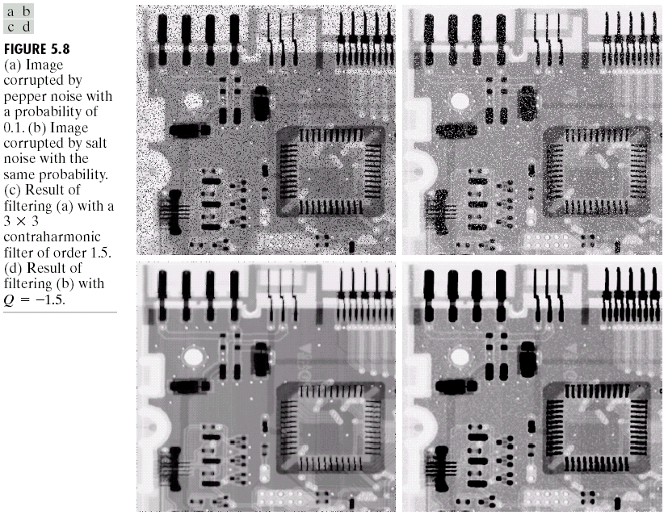
Example: Contra harmonic filter
Image
corrupted
by pepper
noise with
prob. = 0.1
Image
corrupted
by salt
noise with
prob. = 0.1
Image
obtained
using a 3x3
contra-
harmonic
mean filter
With Q = 1.5
Image
obtained
using a 3x3
contra-
harmonic
mean filter
With Q=-1.5
9/25/2023

Slide 32
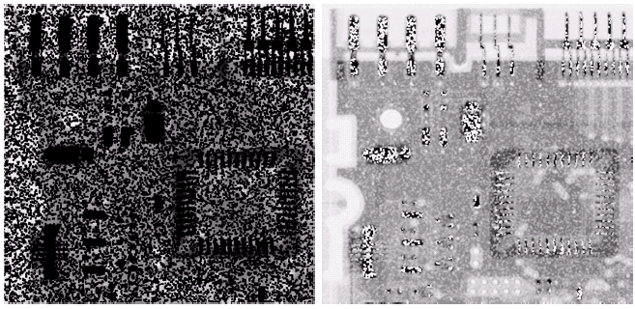
Example: Incorrect use of Contra harmonic filter
Image
corrupted
by pepper
noise with
prob. = 0.1
Image
corrupted
by salt
noise with
prob. = 0.1
Image
obtained
using a 3x3
contra-
harmonic
mean filter
With Q=-1.5
Image
obtained
using a 3x3
contra-
harmonic
mean filter
With Q=1.5
9/25/2023

Slide 33
UNIT – III: Image Restoration and Reconstruction
Order-Statistic Filters
Original image
sub image
Statistic parameters
Mean, Median, Midpoint,
Min, Max, Etc.
Moving
window
Output image

Slide 34
Order-Statistics Filters
Median filter
Max filter
Reduce “dark” noise
(pepper noise)
Min filter
Reduce “bright” noise
(salt noise)
Midpoint filter

Slide 35
Median Filter : How it works
A median filter is good for removing impulse, isolated noise
Salt noise
Pepper noise
Median
Sorted
array
Degraded image
Moving
window
Salt noise
Filter output
Pepper noise
Normally, impulse noise has high magnitude
and is isolated. When we sort pixels in the
moving window, noise pixels are usually
at the ends of the array.
Therefore, it’s rare that the noise pixel will be a median value.

Slide 36
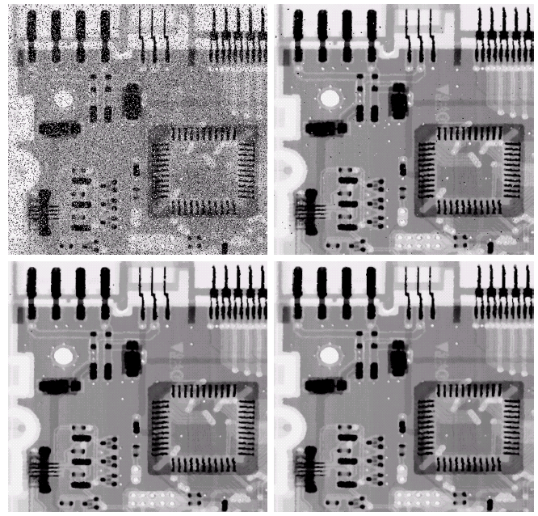
Median Filter : Example
1
2
Image
corrupted
by salt-and-pepper
noise with
p_{a}=p_{b}= 0.1
Images obtained using a 3x3 median filter
3
4

Slide 37
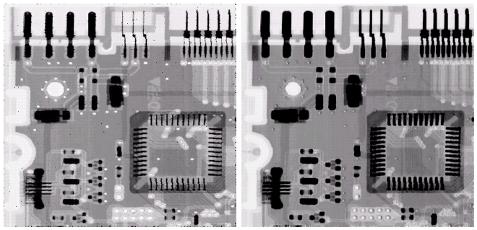
Max and Min Filters: Example
Image
corrupted
by pepper
noise with
prob. = 0.1
Image
corrupted
by salt
noise with
prob. = 0.1
Image
obtained
using a 3x3
max filter
Image
obtained
using a 3x3
min filter

Slide 38
UNIT – III: Image Restoration and Reconstruction
Alpha-trimmed Mean Filter
where g_{r}(s,t) represent the remaining mn-d pixels after removing the d/2 highest and d/2 lowest values of g(s,t).
i.e ά = d/2
Where d value ranges from 0 to (mn-1)
This filter is useful in situations involving multiple types of noise such as a combination of salt-and-pepper and Gaussian noise.
9/25/2023

Slide 39
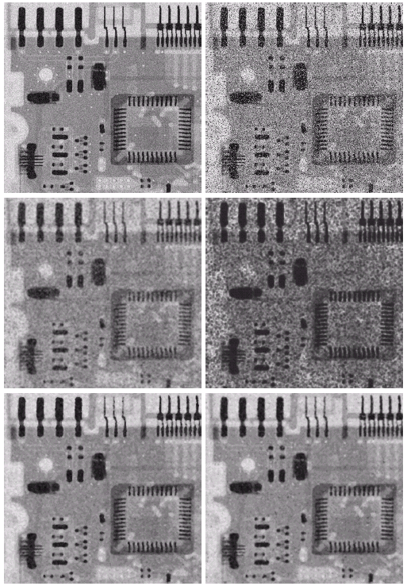
Alpha-trimmed Mean Filter: Example
1
2
Image
additionally
corrupted
by additive
salt-and-
pepper
noise
Image
corrupted
by additive
uniform
noise
2
2
Image
obtained
using a 5x5
arithmetic
mean filter
Image
obtained
using a 5x5
geometric
mean filter

Slide 40
Contd…
Image
additionally
corrupted
by additive
salt-and-
pepper
noise
Image
corrupted
by additive
uniform
noise
2
1
Image
obtained
using a 5x5
median filter
Image
obtained
using a 5x5
alpha-
trimmed
mean filter
with d = 5
2
2

Slide 41
Contd…
Image
obtained
using a 5x5
geometric
mean filter
Image
obtained
using a 5x5
arithmetic
mean filter
Image
obtained
using a 5x5
alpha-
trimmed
mean filter
with d = 5
Image
obtained
using a 5x5
median filter

Slide 42
UNIT – III: Image Restoration and Reconstruction
Adaptive Filter
Filter behavior depends on statistical characteristics of local areas inside mxn moving window
More complex but superior performance compared with “fixed” filters
Statistical characteristics:
Local mean:
Noise variance:
Local variance:
9/25/2023

Slide 43
UNIT – III: Image Restoration and Reconstruction
Adaptive, Local Noise Reduction Filter
Purpose: want to preserve edges
Algorithm:
1. If σ_{η}² is zero, → No noise
the filter should return g(x,y) because g(x,y) = f(x,y)
2. If σ_{L}² is high relative to σ_{η}², → Edges (should be preserved),
the filter should return the value close to g(x,y)
3. If σ_{L}² = σ_{η}², → Areas inside objects
the filter should return the arithmetic mean value m_{L}
Formula:
9/25/2023

Slide 44
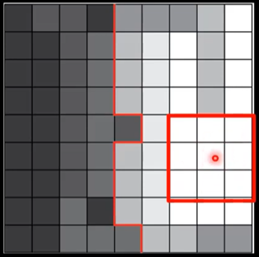
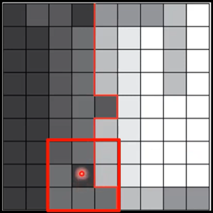
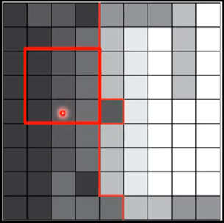
UNIT – III: Image Restoration and Reconstruction
Contd…
9/25/2023

Slide 45
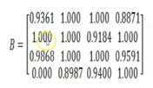
UNIT – III: Image Restoration and Reconstruction
Contd…
9/25/2023

Slide 46
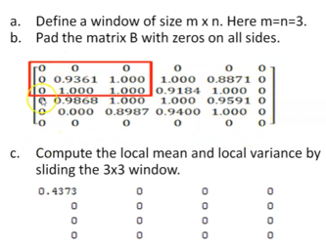
UNIT – III: Image Restoration and Reconstruction
Contd…
9/25/2023

Slide 47
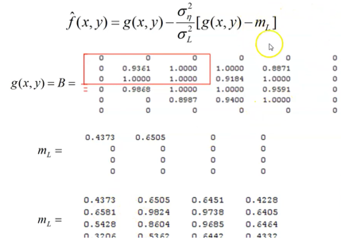
UNIT – III: Image Restoration and Reconstruction
Contd…
9/25/2023

Slide 48
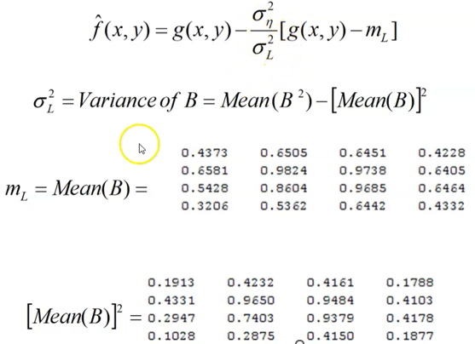
UNIT – III: Image Restoration and Reconstruction
Contd…
9/25/2023

Slide 49
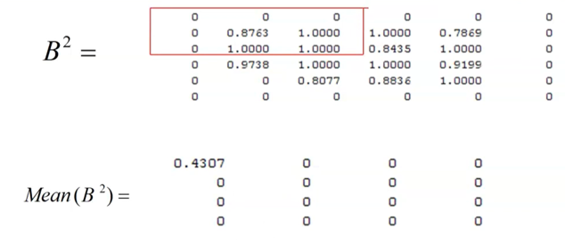
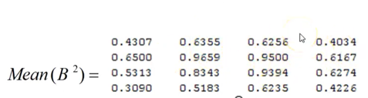
UNIT – III: Image Restoration and Reconstruction
Contd…
9/25/2023

Slide 50
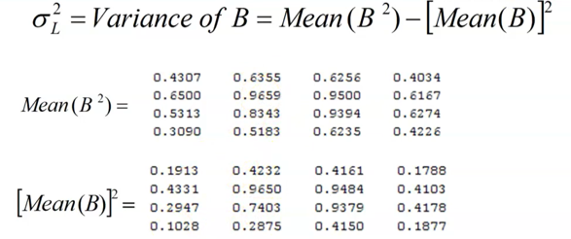
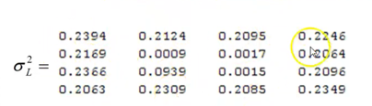
UNIT – III: Image Restoration and Reconstruction
Contd…
9/25/2023

Slide 51
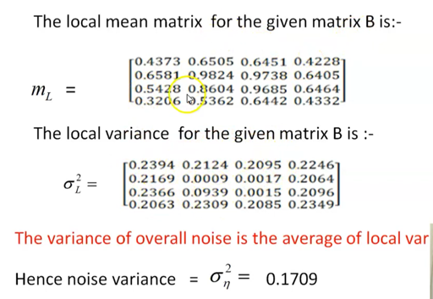
UNIT – III: Image Restoration and Reconstruction
Contd…
9/25/2023

Slide 52
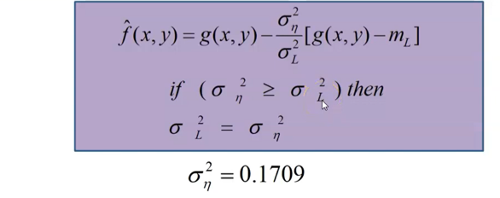
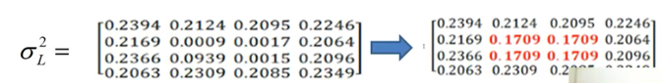
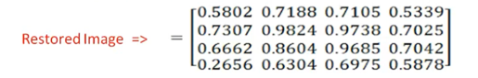
UNIT – III: Image Restoration and Reconstruction
Contd…
9/25/2023

Slide 53
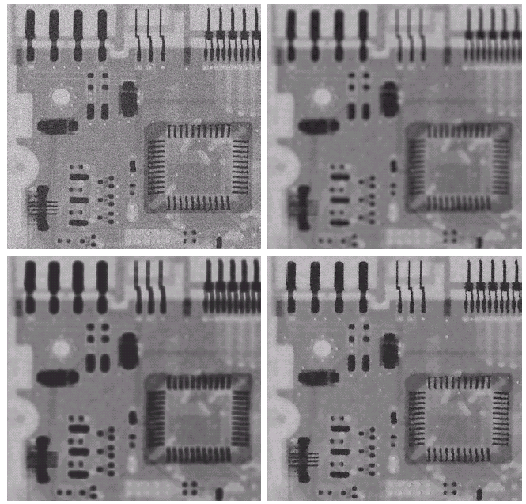
Example: Adaptive Noise Reduction Filter
Image
corrupted
by additive
Gaussian
noise with
zero mean
and s²=1000
Image
obtained
using a 7x7
arithmetic
mean filter
Image
obtained
using a 7x7
adaptive
noise
reduction
filter
Image
obtained
using a 7x7
geometric
mean filter
9/25/2023

Slide 54
UNIT – III: Image Restoration and Reconstruction
Adaptive Median Filter
Purpose: want to remove impulse noise while preserving edges
Algorithm: Level A: A1= z_{median} – z_{min}
A2= z_{median} – z_{max}
If A1 > 0 and A2 < 0, goto level B
Else increase window size
If window size <= S_{max} repeat level A
Else return z_{xy}
Level B: B1= z_{xy} – z_{min}
B2= z_{xy} – z_{max}
If B1 > 0 and B2 < 0, return z_{xy}
Else return z_{median}
Where z_{min} = minimum gray level value in S_{xy}
z_{max} = maximum gray level value in S_{xy}
z_{median} = median of gray levels in S_{xy}
z_{xy} = gray level value at pixel (x,y)
S_{max} = maximum allowed size of S_{xy}

Slide 55
UNIT – III: Image Restoration and Reconstruction
Contd…
Determine
whether z_{median}
is an impulse or not
Level A: A1= z_{median} – z_{min}
A2= z_{median} – z_{max}
Else → Window is not big enough increase window size
If window size <= S_{max} repeat level A
Else return z_{xy}
→ z_{median} is not an impulse
B1= z_{xy} – z_{min}
B2= z_{xy} – z_{max}
If B1 > 0 and B2 < 0, → z_{xy} is not an impulse
return z_{xy} → to preserve original details
Else
return z_{median} → to remove impulse
If A1 > 0 and A2 < 0, goto level B
Level B:
Determine
whether z_{xy}
is an impulse or not
9/25/2023

Slide 56
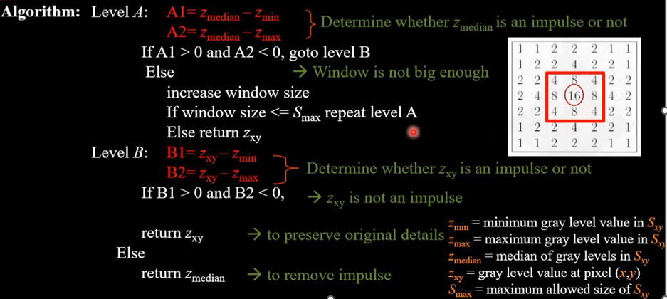
UNIT – III: Image Restoration and Reconstruction
Contd…
9/25/2023

Slide 57
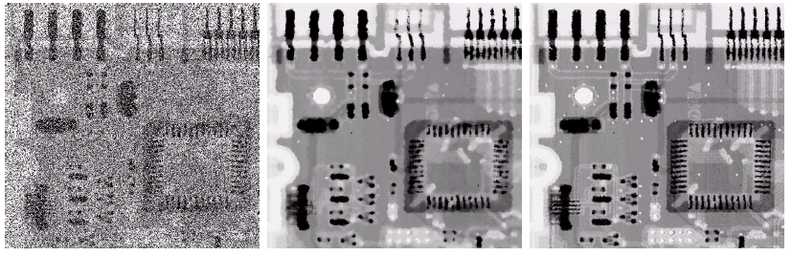
UNIT – III: Image Restoration and Reconstruction
Example: Adaptive Median Filter
Image corrupted
by salt-and-pepper
noise with
p_{a}=p_{b}= 0.25
Image obtained
using a 7x7
median filter
Image obtained
using an adaptive
median filter with
S_{max} = 7
More small details are preserved
9/25/2023

Slide 58
UNIT – III: Image Restoration and Reconstruction
Estimation of Degradation Model
or
Purpose: to estimate h(x,y) or H(u,v)
Why?
If we know exactly h(x,y), regardless of noise, we can do deconvolution to get f(x,y) back from g(x,y).
Methods:
1. Estimation by Image Observation
2. Estimation by Experiment
3. Estimation by Modeling
9/25/2023

Slide 59
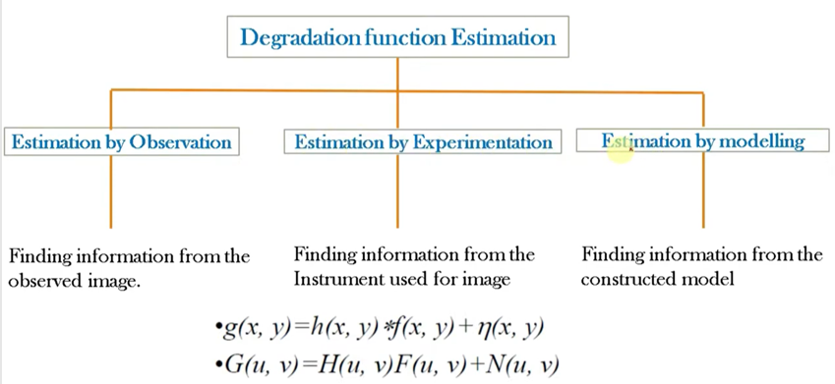
UNIT – III: Image Restoration and Reconstruction
Estimation of Degradation Model
9/25/2023

Slide 60
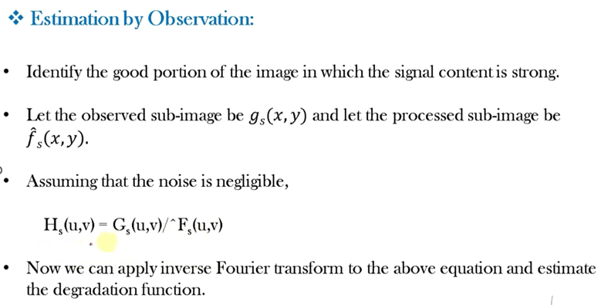
UNIT – III: Image Restoration and Reconstruction
Estimation of Degradation Model
9/25/2023

Slide 61
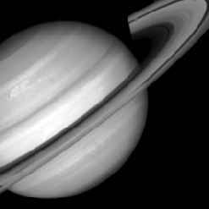
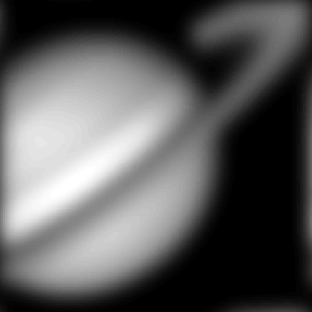
Estimation by Image Observation
Original image (unknown)
Degraded image
f(x,y)
f(x,y)*h(x,y)
g(x,y)
Observation
DFT
Subimage
Estimated Transfer
function
Restoration
process by
estimation
DFT
Reconstructed
Subimage
This case is used when we
know only g(x,y) and cannot
repeat the experiment!

Slide 62
UNIT – III: Image Restoration and Reconstruction
Estimation of Degradation Model
9/25/2023

Slide 63

UNIT – III: Image Restoration and Reconstruction
Estimation of Degradation Model
9/25/2023

Slide 64

Estimation by Experiment
- Used when we have the same equipment set up and can repeat the experiment.
Input impulse image
Response image from
the system
System
H( )
DFT
DFT

Slide 65

UNIT – III: Image Restoration and Reconstruction
Estimation of Degradation Model
9/25/2023

Slide 66

Estimation by Modeling
- Used when we know physical mechanism underlying the image formation process that can be expressed mathematically.
Original image
Severe turbulence
Example:
Atmospheric
Turbulence model
k = 0.0025
Mild turbulence
Low turbulence
k = 0.001
k = 0.00025

Slide 67
Estimation by Modeling: Motion Blurring
Assume that camera velocity is
The blurred image is obtained by
where T = exposure time.

Slide 68
Contd…
Then we get, the motion blurring transfer function:
For constant motion

Slide 69

Motion Blurring Example
For constant motion
Original image
Motion blurred image
a = b = 0.1, T = 1

Slide 70
Inverse Filter
From degradation model:
after we obtain H(u,v), we can estimate F(u,v) by the inverse filter:
Noise is enhanced
when H(u,v) is small.
To avoid the side effect of enhancing
noise, we can apply this formulation
to freq. component (u,v) with in a
radius D₀ from the center of H(u,v).
In practical, the inverse filter is not Popularly used.

Slide 71

Example: Inverse Filter
Result of applying
the full filter
Result of applying
the filter with D₀=40
Original image
Blurred image
Due to Turbulence
Result of applying
the filter with D₀=70
Result of applying
the filter with D₀=85

Slide 72

Wiener Filter: Minimum Mean Square Error Filter

Slide 73
Wiener Filter: Minimum Mean Square Error Filter
Objective: optimize mean square error:
Wiener Filter Formula:
where
H(u,v) = Degradation function
S_{η}(u,v) = Power spectrum of noise
S_{f}(u,v) = Power spectrum of the undegraded image

Slide 74
Approximation of Wiener Filter
Wiener Filter Formula:
Difficult to estimate
Approximated Formula:
Practically, K is chosen manually to obtained the best visual result!
9/25/2023

Slide 75

Example: Wiener Filter
Result of the
full inverse filter
Result of the inverse
filter with D₀=70
Original image
Blurred image
Due to Turbulence
Result of the
full Wiener filter

Slide 76
Contd…
Result of the inverse
filter with D₀=70
Original image
Blurred image
Due to Turbulence
Result of the
Wiener filter

Slide 77

Example: Wiener Filter and Motion Blurring
Image
degraded
by motion
blur +
AWGN
Result of the
inverse filter
Result of the
Wiener filter
σ_{η}²=650
σ_{η}²=325
Note: K is
chosen
manually
σ_{η}²=130

Slide 78
Constrained Least Squares Filter
Degradation model:
We get a constrained least square filter
where
P(u,v) = Fourier transform of Laplacian operator =
9/25/2023

Slide 79

Example: Constrained Least Squares Filter
Constrained least square filter
γ is adaptively adjusted to achieve the best result.
Results from the previous slide obtained
from the constrained least square filter
9/25/2023

Slide 80
Contd…
Image
degraded
by motion
blur +
AWGN
Result of the
Constrained
Least square
filter
Result of the
Wiener filter
σ_{η}²=650
σ_{η}²=325
σ_{η}²=130

